Slide 1
”Helping All Students Succeed”
Project Discovery Alexandria
Annual Legacy Scholarship Fundraiser
November 7, 2015

Slide 2
Welcome
to the
Annual Legacy Scholarship
Fundraiser

Slide 3
Our Mission
The mission of Project Discovery Alexandria is to prepare and motivate first generation college eligible students to seek,
access and utilize opportunities
in higher
education.

Slide 4
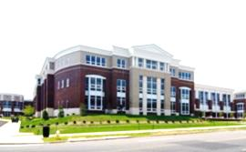
Mission (Cont’d)
This program motivates and prepares first generation college-eligible students to access opportunities in higher education. It is based at T. C. Williams High School and Minnie Howard 9th Grade Center.

Slide 5
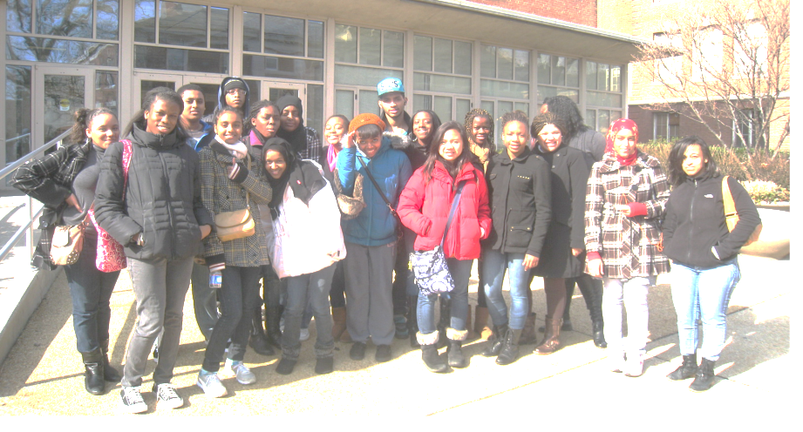
College Tour Participants

Slide 6
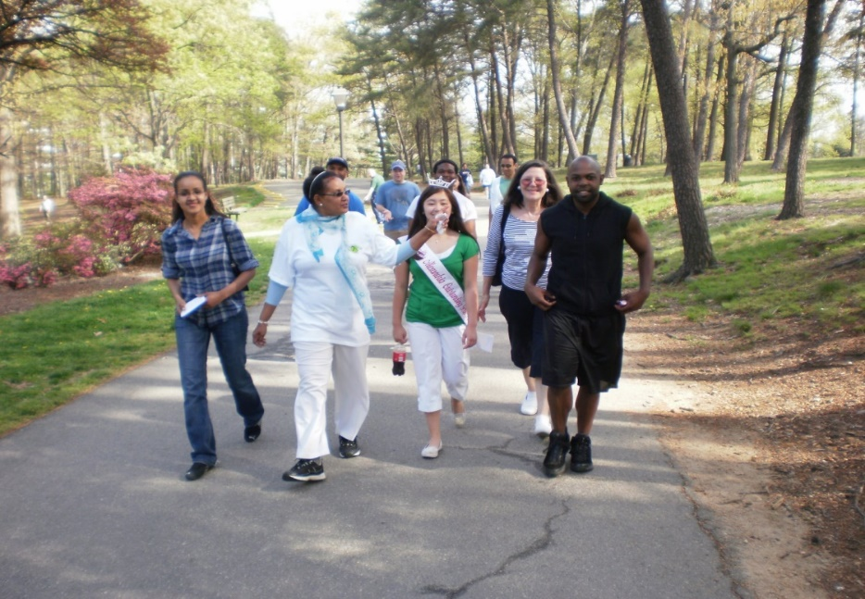
Walkathon 2009
Remembering our Past

Slide 7
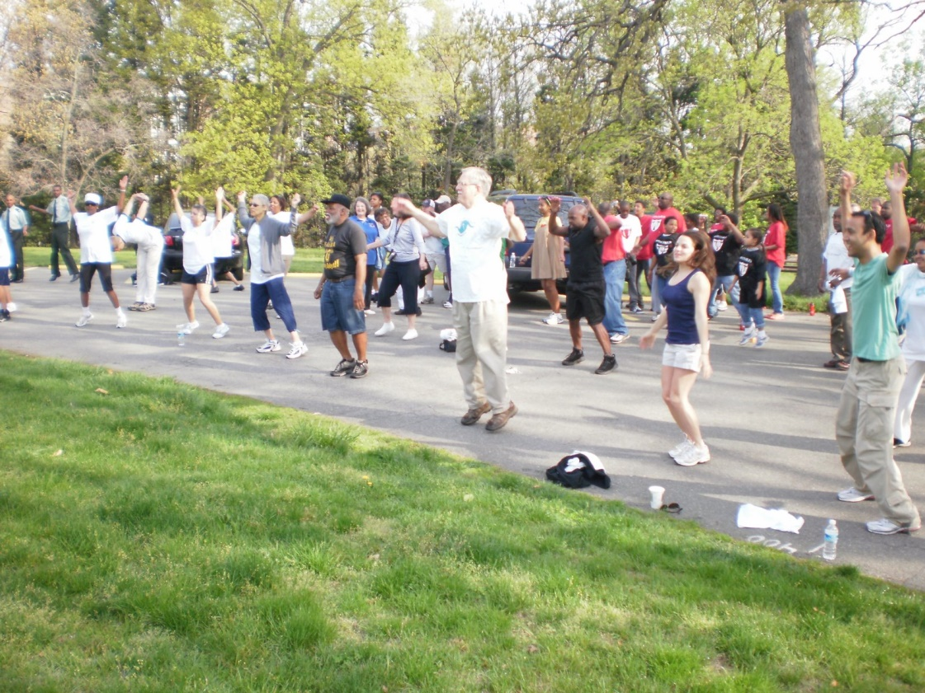

Slide 8
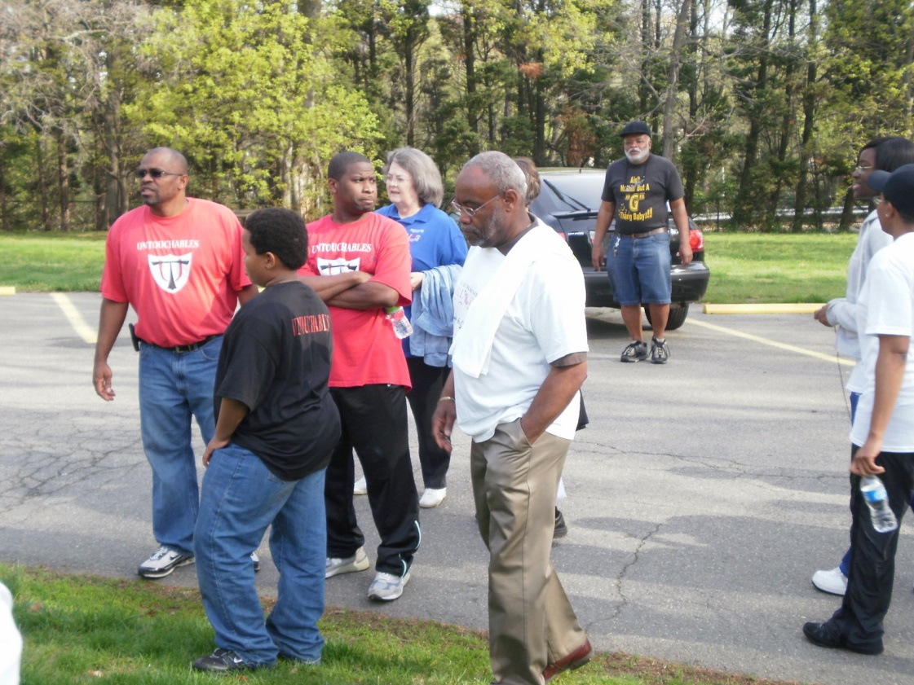

Slide 9
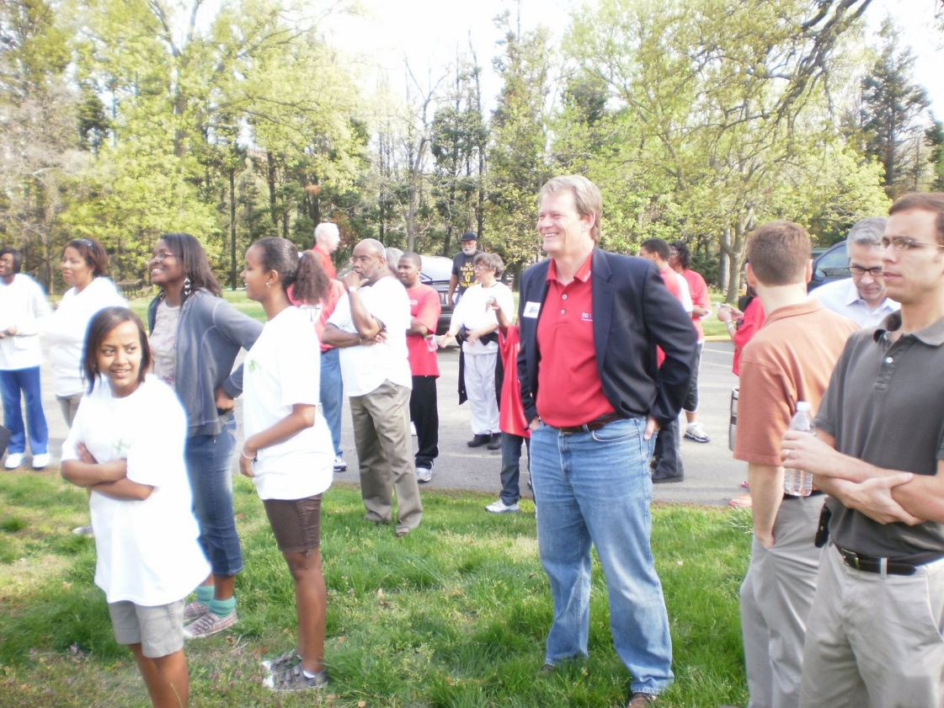

Slide 10
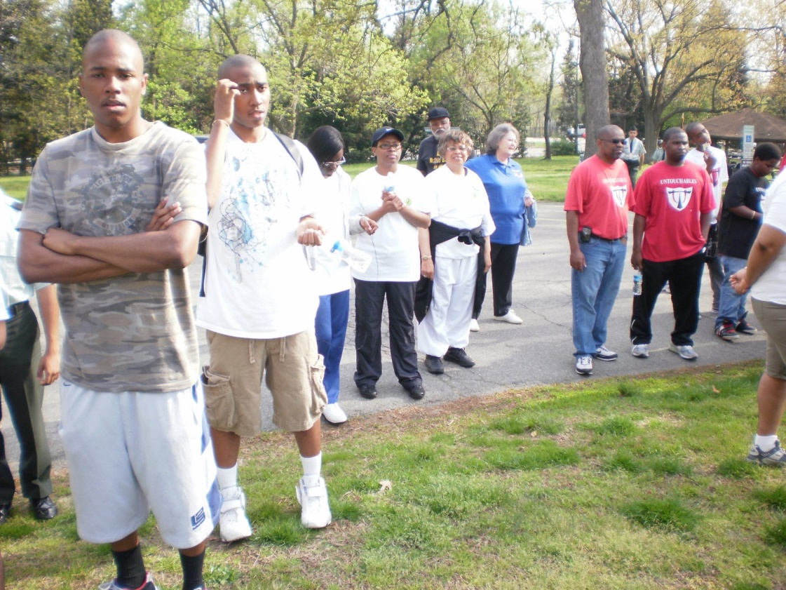

Slide 11
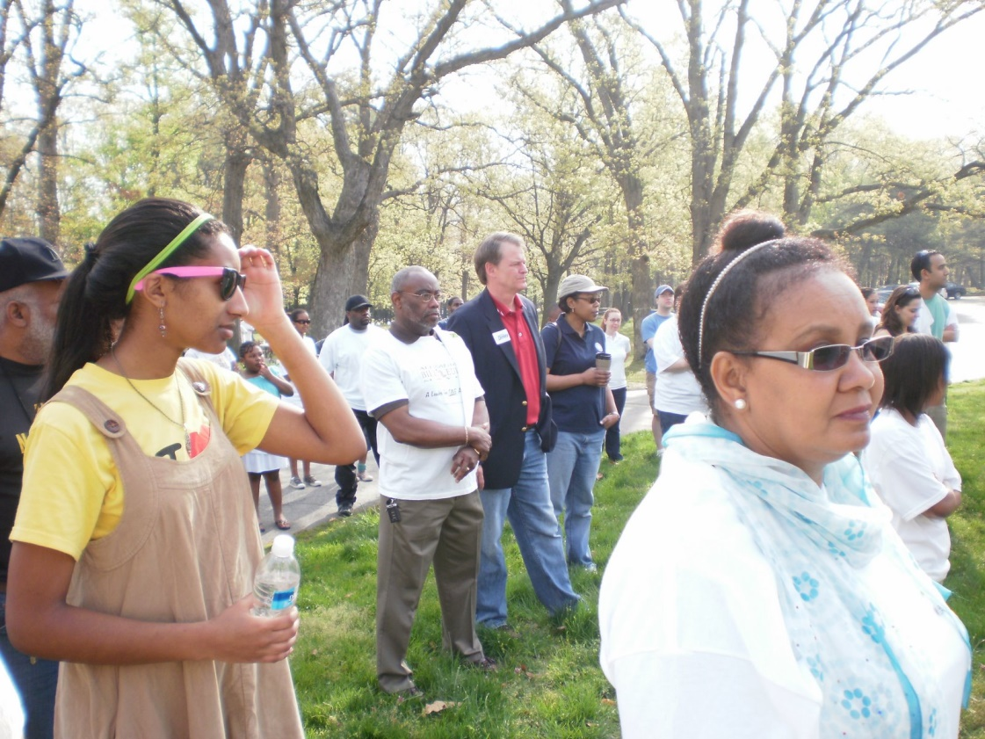

Slide 12
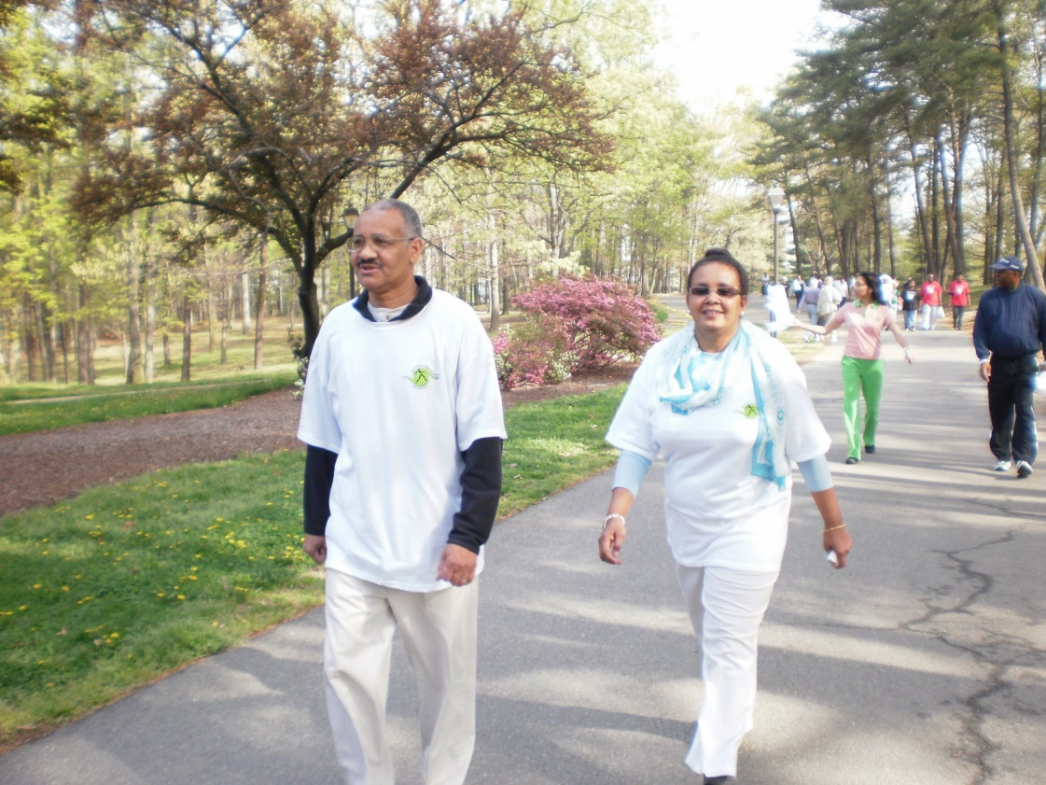

Slide 13
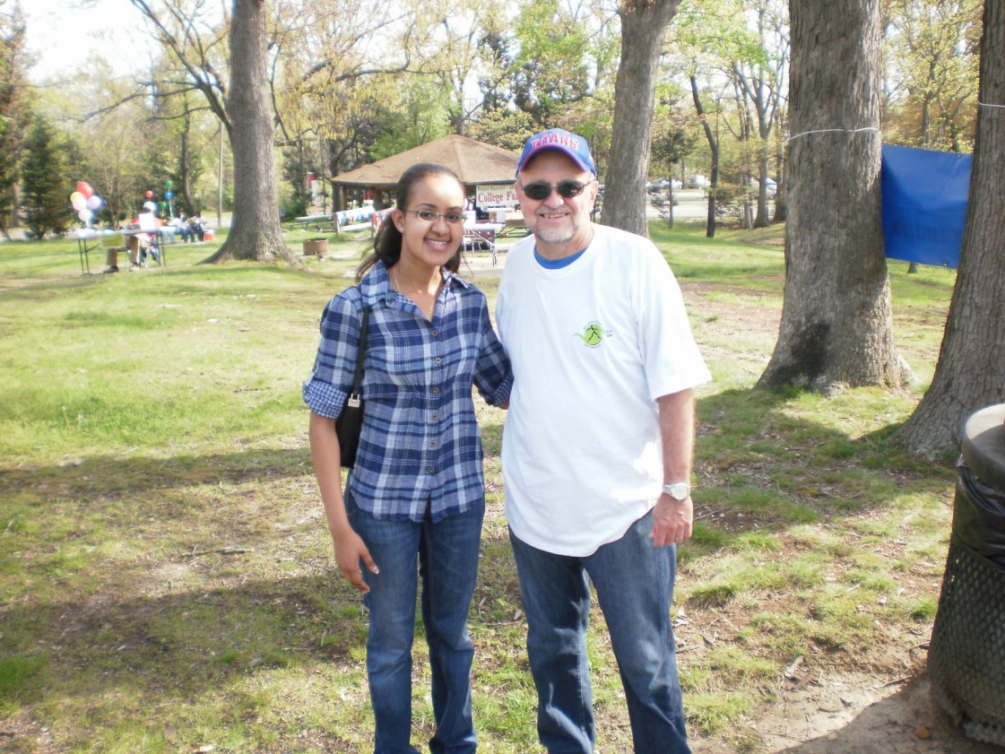

Slide 14
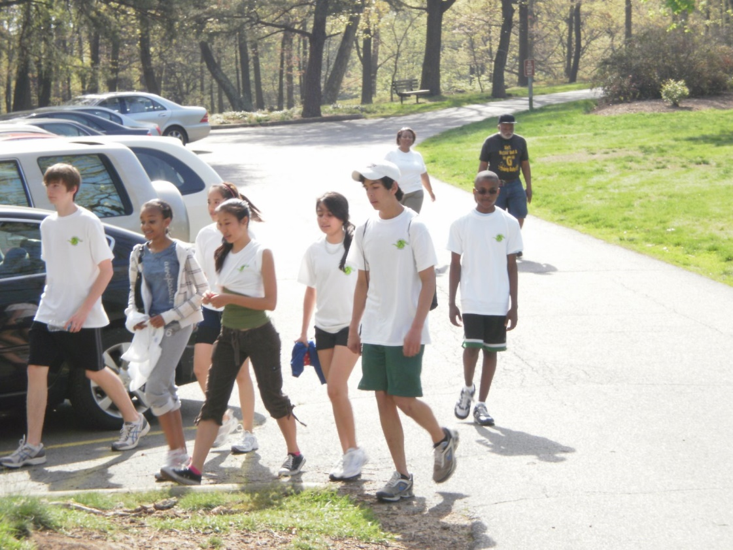

Slide 15
